Slide 1

深圳市金驹科技有限公司
Shenzhen Jinju Technology Co, Ltd.
承认书
Acknowledgment
客户名称（ client‘s name ）：
客户料号（ Customer item number ）：
产品型号（ Product number ）：
JJ-5148200-V3
产品名称（ product name ）：
DMX512单色恒流电源
编制日期（ Date of preparation ）：
制定
（Formulate）
审核
（Review）
批准
（Approve）
承认
（Admit）
审核
（Review）
批准
（Approve）
厂商：深圳市金驹科技有限公司
地址：深圳市龙城街道龙西社区清水路鹏大地工业区14栋4楼
电话：0755 – 84861299 传真：0755 - 84860299
邮箱:2880362299@qq.com 网址：http://www.szjjpower.cn/ http://www.szjjled.com/
Manufacturer: Shenzhen Jinju Technology Co., Ltd.
Address: 4th Floor, Building 14, Peng Dadi Industrial Zone, Qingshui Road, Longxi Community, Longcheng District, Shenzhen
Tel: 0755 – 84861299 Fax: 0755 – 84860299 E-mail: 2880362299@qq.com
Website: http://www.szjjpower.cn/ http://www.szjjled.com/

Slide 2
产品描述(product description)：
本电源是一款高稳定性的LED恒流驱动电源。内部滤波器件使用品牌绿宝石电容，高频低阻，105℃高温下，时长8000H，低温时间更长。具有启动快速，兼容负载范围宽，保护功能齐全，输入DC36-48V ，输出DC24-36V，高精确的恒流控制，极高的效率和可靠的性能，以及小型的外观结构会使你的灯具更加趋于完美。
✶ The power supply is a high stability LED constant current drive power supply. The internal filter uses brand emerald capacitors, with high frequency and low resistance, It lasts 8000H at 105 ℃ for a longer time at low temperature . With fast start, wide compatible load range, complete protection function, input DC36-48V, output DC24-36V, high-precision constant current control,high extremely and reliable performance, and small appearance structure,your lamp will be more perfect.
产品特点(Features)：
输入DC36-48V，加防反接保护功能。
输出范围广，输出DC24-36V,恒流4.5A。
输出开路，短路，过压，过温保护。
高效率。
支持DMX512编码调光。
采用LED专用防水环氧树脂AB胶，通过导热胶与铝壳接触，散热效果极佳，满负载输出时外壳表面温度不超过65℃(在环境25℃测量) ,室内户外均可使用，两端各设两个机械固定孔位，适用于多种内部安装应用。
Input DC36-48V, plus anti-reverse protection function.
Wide output range, output DC24-36V, constant current 4.5A.
Output open circuit, short circuit, over voltage, over temperature protection.
high efficiency.
Support DMX512 encoding dimming.
Use LED special waterproof epoxy resin AB glue, contact with aluminum shell through thermal conductive glue, excellent heat dissipation effect, shell surface temperature does not exceed 65℃ (measured at 25℃ in the environment) when full load output, both indoor and outdoor can be used, both ends Each has two mechanical fixing holes, suitable for a variety of internal installation applications.

Slide 3
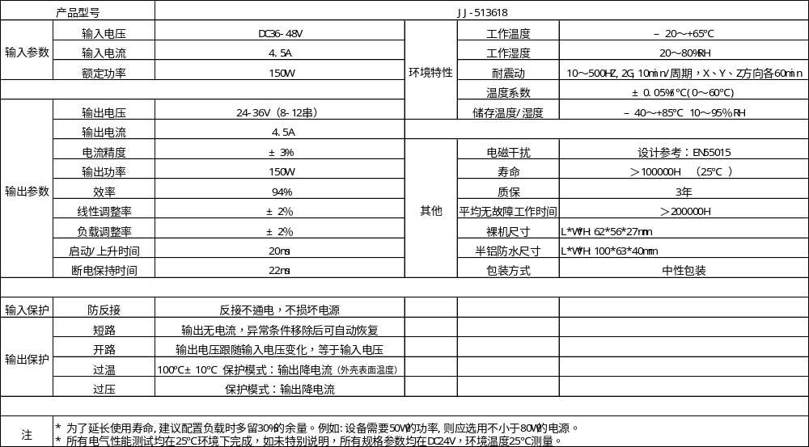
电气规格(Electrical specifications)：

Slide 4
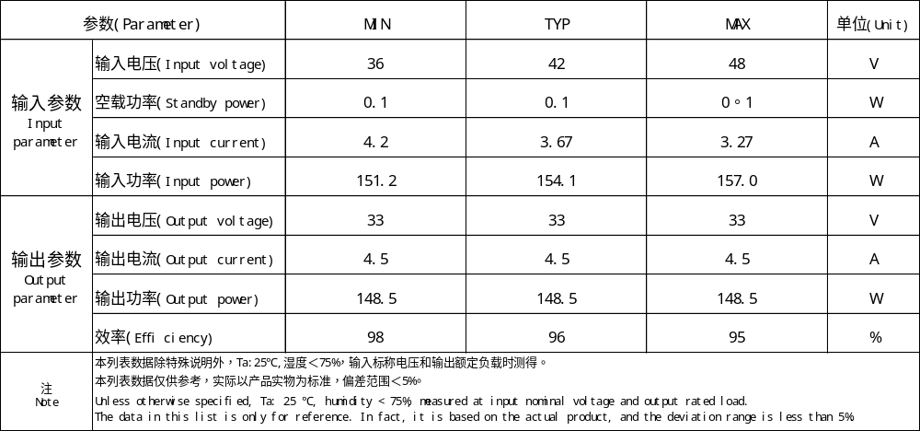
电性参数(Electrical parameters)：

Slide 5
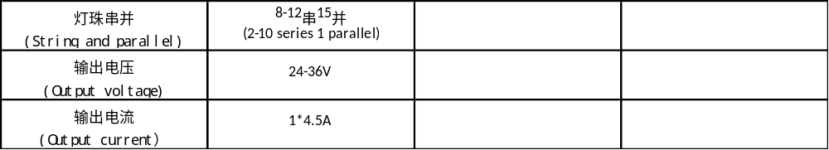
产品适用范围(Scope of application)：

Slide 6
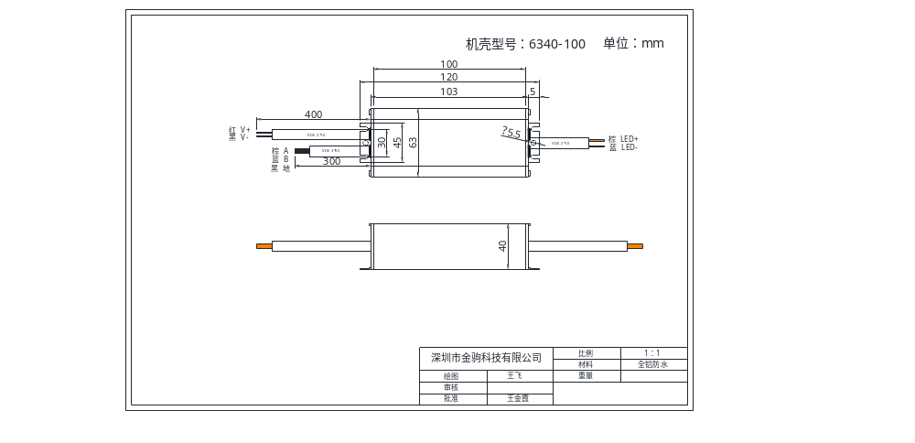
安装尺寸图(Installation dimension drawing):

Slide 7
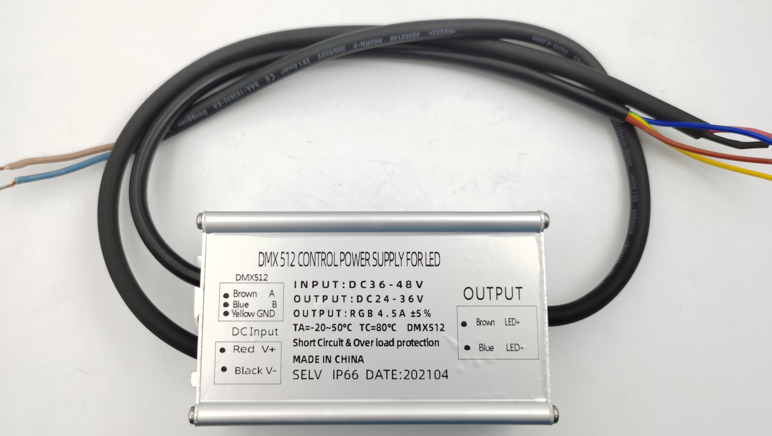
防水图(Waterproof figure):

Slide 8
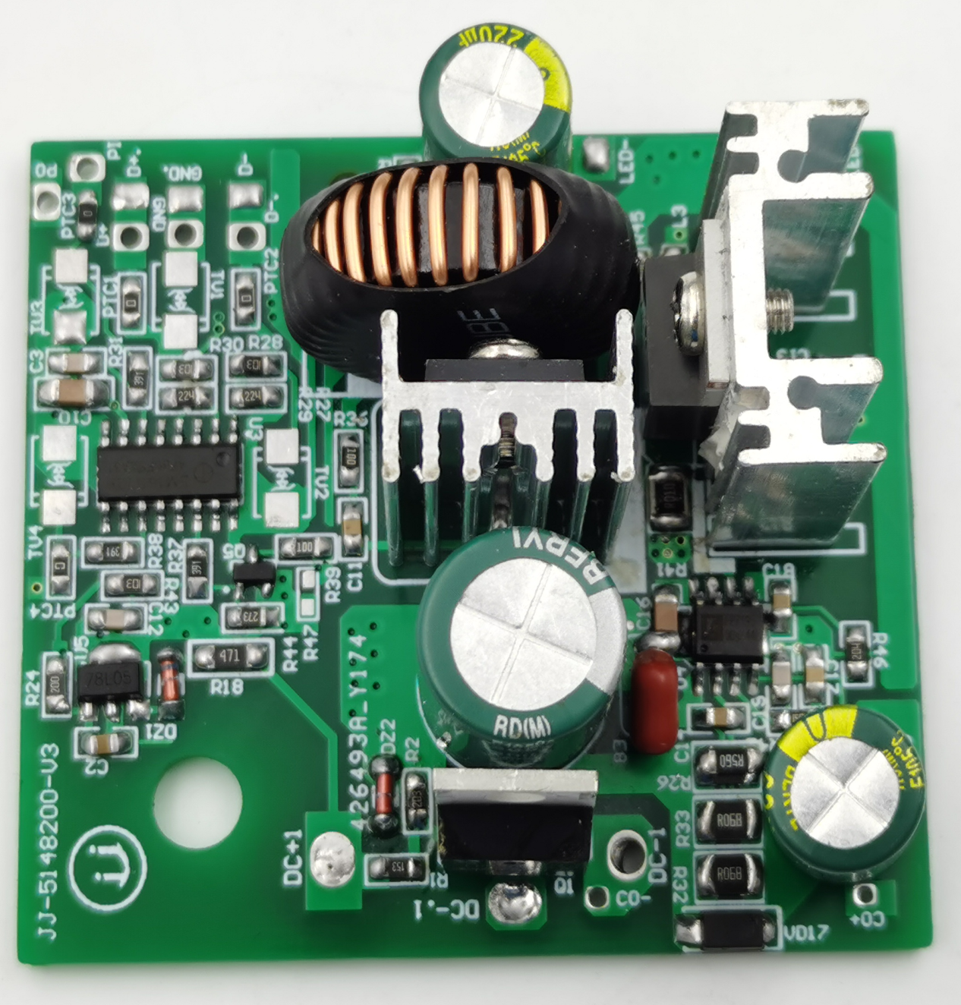
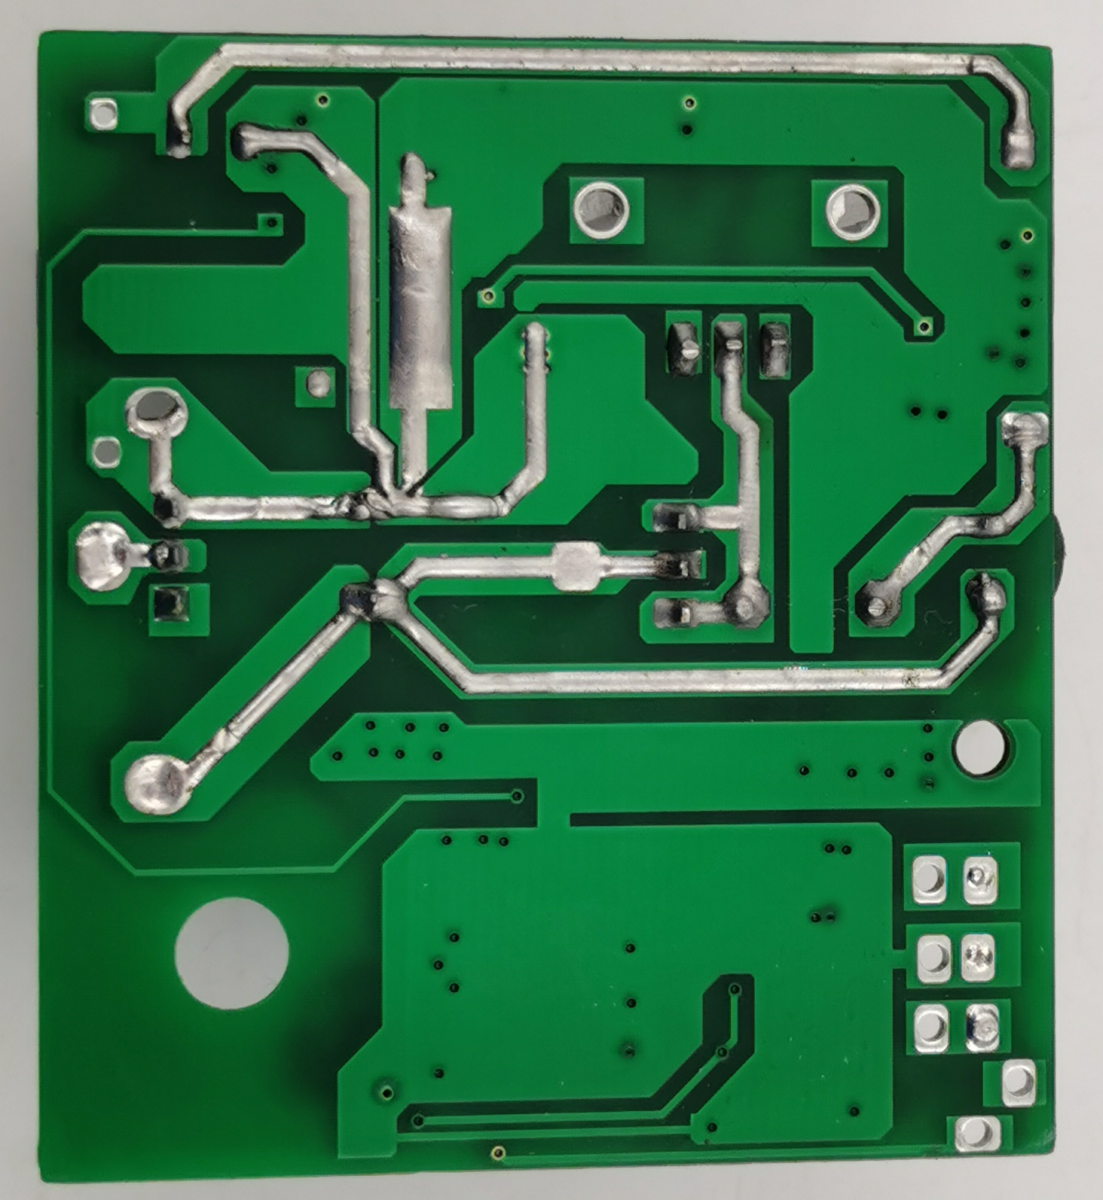
产品图（ Product figure ）：

Slide 9
产品使用说明(Product instructions):
本产品主要应用于LED灯具（照明灯，景观灯, 水底投光灯、太阳能路灯等），整机功率为150W。
本产品是长形设计，操作时避免产品变形。
产品输入端是直流电输入，对应标签上DC“V+”和DC“V-”；输出端对应标签上“LED+”和“LED-”，“LED+”为输出正极，接LED正极，
“LED-”为输出负极，接LED负极；信号控制端对应标签上“A”、 “B” 、 “GND” 、 “PI” “PO” ，请勿与输入、输出端短接。
使用时请注意安全，防止触电，避免与金属短路，必须用绝缘材料套好后方能放入灯具内。
注：在使用本电源时，请注意区分输入端和输出端，确保正确接线，核对无误后才能通电。
注：请确保输入线正负极不接反，确认无误，再开电源。
注：请先接好DC输出端的负载，确认无误，再开电源。
✶ This product is mainly used in LED lamps (lighting lamps, landscape lamps, underwater flood lights, solar street lamps, etc.), the power of the whole machine is 150W.
✶ This product is a long design, to avoid product deformation during operation.
✶ The input end of the product is a direct current input, corresponding to DC "V+" and DC "V-" on the label; the output end corresponds to "LED+" and "LED-" on the label, "LED+" is the positive output, connected to the positive LED,"LED-" is the negative pole of the output, connected to the negative pole of the LED; the signal control terminal corresponds to the "P+" and "P-" on the label, please do not short circuit with the input and output terminals.
✶ When using it, please pay attention to safety, prevent electric shock, and avoid short circuit with metal. It must be covered with insulating material before it can be placed in the lamp.
Note: When using this power supply, please pay attention to distinguish the input end and output end, ensure the correct wiring, and check the power before powering on.
Note: Please make sure that the positive and negative poles of the input line are not reversed, confirm that they are correct, and turn on the power.
Note: Please connect the load on the DC output first, make sure it is correct, and then turn on the power.

Slide 10
常见故障及处理方法 Common faults and Solutions
灯具不亮☞
Lamps and lanterns are not bright
请切断DC输入端并检查：
Please cut off the DC input and check:
1.DC输出端是否接触不良；
Whether the DC output terminal is in poor contact;
2.DC输出端正负极是否接反；
Whether the positive and negative poles of DC output end are connected reversely;
3.DC输入端是否接触不良；
Whether the DC input is in poor contact;
4.DC输入供电电源，功率是否够大，能否正常带的起 18W负载。
Whether the power of DC input power supply is large enough and whether it can normally carry 18W load.
排除以上故障后再测试。
Remove the above faults before testing.
灯具抖闪☞ Lighting flicker
请切断DC输入端，检查DC输出端：
Please cut off the DC input and check the DC output:
1.有无过载、超载；
Whether there is overload or overload;
2.电源设计参数与实际使用参数不符。
The power supply design parameters are inconsistent with the actual use parameters.
注：产品在使用过程当中如遇到其它疑问和问题，请及时与我司沟通、反馈不良信息，我司将积极助贵公司解决好问题。
Note: in case of any other questions and problems during the use of the product, please communicate with our company in time and feed back the bad information. Our company will actively help your company to solve the problems.

